Slide 1

9 M 2020 RESULTS
13 NOVEMBER 2020

Slide 2
DISCLAIMER
This presentation might contain certain forward-looking statements that reflect the Company’s management’s current views with respect to future events and financial and operational performance of the Company and its subsidiaries. These forward-looking statements are based on Newlat Food S.p.A.’s current expectations and projections about future events.
Any reference to past performance of Newlat Food shall not be taken as a representation or indication that such performance will continue in the future.
This presentation does not constitute an offer to sell or the solicitation of an offer to buy Newlat’s securities, nor shall the document form the basis of or be relied on in connection with any contract or investment decision relating thereto, or constitute a recommendation regarding the securities of Newlat Food.
Newlat’s securities referred to in this document have not been and will not be registered under the U.S. Securities Act of 1933 and may not be offered or sold in the United States absent registration or an applicable exemption from registration requirements.
Statement
Rocco Sergi, the Manager responsible for preparing the corporate accounting documents, declares that, pursuant to art. 154-bis, paragraph 2, of the Legislative Decree no. 58 of February 24, 1998, the accounting information contained herein correspond to document results, books and accounting records.

Slide 3


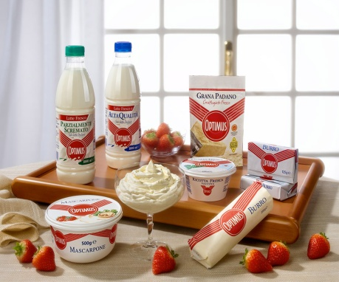

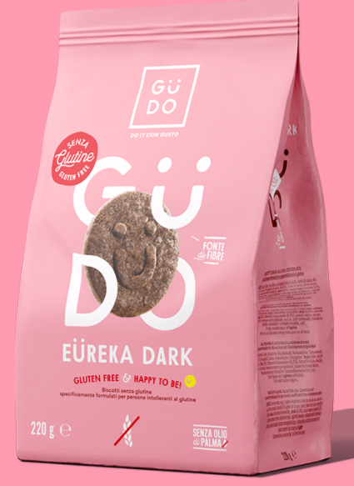
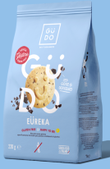
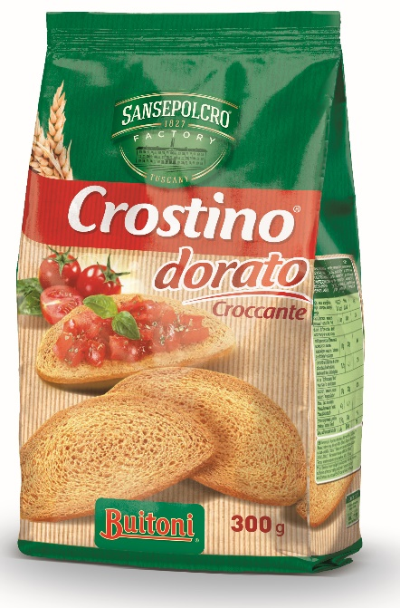
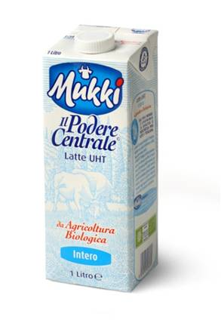
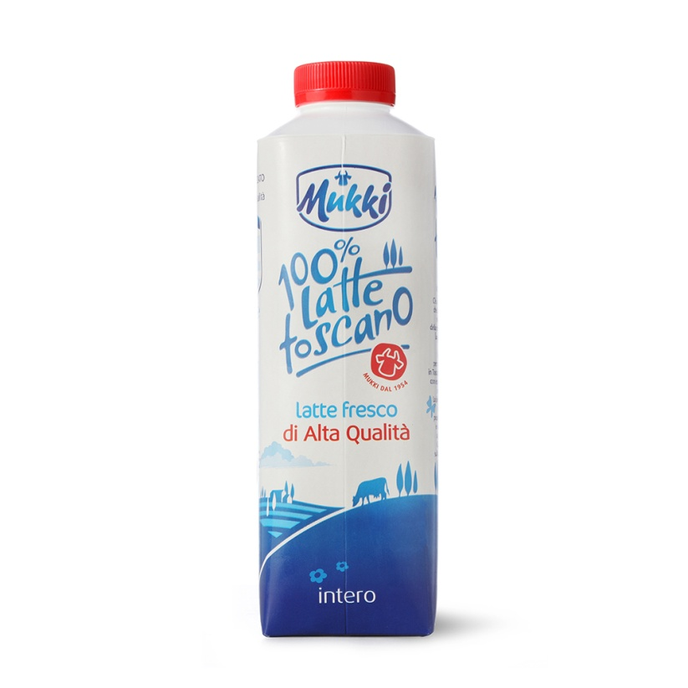
KEY MESSAGES
Resilient business model shown in the capability to adapt to sudden challenges.
Dynamic approach to business development with launch of new products across all categories.
Successful and quick implementation of synergies with CLI exceeding expectations.
Strong ability to generate cash at Group level.
Dedication to M&A and further business development.

Slide 4
9M 2020 KEY FINANCIAL HIGHLIGHTS
AGGREGATE REVENUES
€372.7m, +5.4% vs. 9M 2019
with double digit growth in pasta, bakery and special products
Germany: 14.5% growth
Organic growth: +4%
EBITDA
Adj. EBITDA €37.8m, +58% vs. 9M 2019
EBITDA margin 10.2% vs. 6.8% 9M 2019
with high double-digit margins in milk, dairy, bakery and special products.
FREE CASH FLOW
FCF was € 30.8 million. EBITDA FCF conversion 81.5%,
confirming the Company’s ability to generate free cash flow.
NET INCOME
Reported Net Income equal to € 30.5 million.
Adj. NI €11.3 m vs. €2.15 in 9M 2019 after deducting €19.3 million negative goodwill .
NET FINANCIAL POSITION
Aggregate NFP equal to -€8.8m vs. -€35.3m in FY 2019 PF
Excluding IFRS 16 lease liabilities, NFP is positive by € 8.4 million.

Slide 5
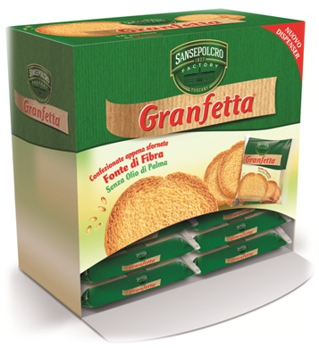




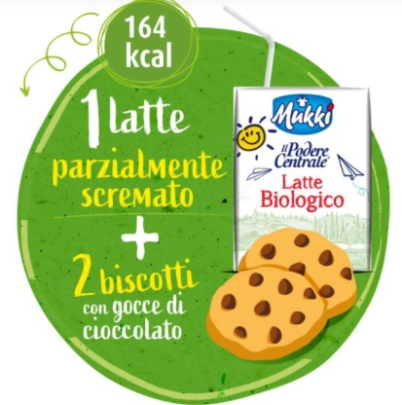

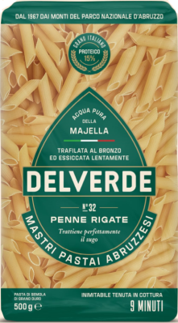


RECENT COMMERCIAL INITIATIVES
PRE-PORTIONED SNACKS
SUSTAINABILITY &
SUPPORTING LOCAL BUSINESSES
MASCARPONE BY AMAZON
HEALTHY SNACKS
FOR KIDS
LAUNCH OF DELVERDE
IN GERMANY and NEW PACK IN ITALY
PROTEIN AND VITAMIN
ENRICHED DRINKS

Slide 6
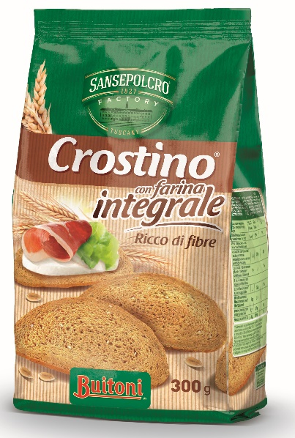



OUTPERFORMING IN THE BREAD SUB. MARKET
Source: IRI data updated on 25 October 2020

Slide 7
9M 2020 SALES
BREAKDOWN AND ANALYSIS

Slide 8
REVENUES AND COSTS IN CONSTANT IMPROVEMENT
Revenue (€m)
The first 9 months of 2020 had a positive impact on sales, with an increase of 5.4% compared to 9M 2019. The three quarters were impacted positively by the pandemic, and sale increase remained stable in Q3 on average.
Cost of goods sold was equal to 77.4% of sales as opposed to 80.1% in 9M 2019, this was mainly driven by a more aggressive procurement policy of raw materials and finished products.
+5.4%

Slide 9
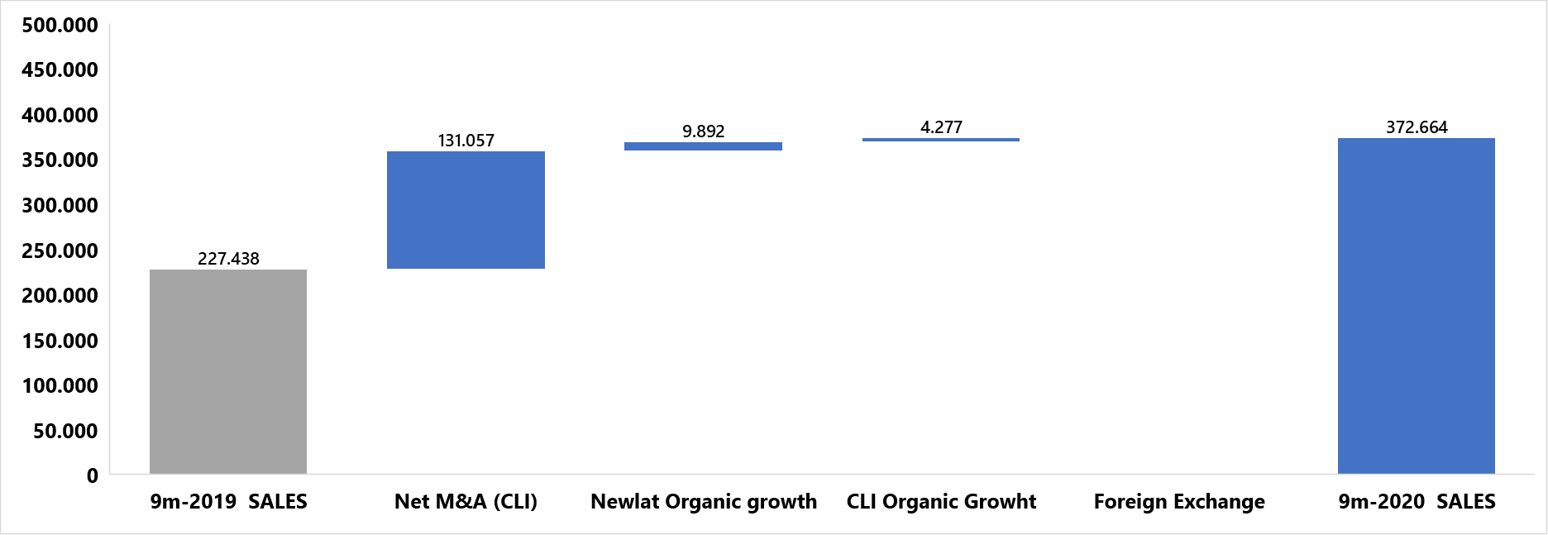
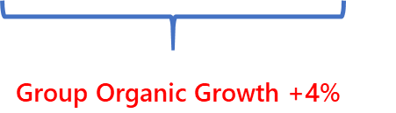
9 MONTHS ORGANIC and M&A GROWTH
(1) For the sake of consistency with previous presentations, 9m 2019 sales include Delverde and Newlat GmbH from 1 January 2019.
(2) Organic growth refers to like-for-like growth vs. 9m 2019, excluding the effect of Centrale del Latte d’Italia.
(3) Net M&A growth refers to the revenue deriving from CLI.

Slide 10
POSITIVE YOY ORGANIC GROWTH
+8.1%
+3.5%
-1.8%
+6.8%
-2%
+9.4%
+4.35%
+2.2%
+3.3%
+5.7%
+6.8%
+8.1%

Slide 11
POSITIVE EBITDA GROWTH THROUGHOUT THE Q’s
+65%
+337%
+358%
+29%
-2%
+62%
+29%
+197%
+346%
+11%
+29%
+358%

Slide 12
REVENUE BREAKDOWN BY BUSINESS UNIT
Revenues related to the pasta business unit show an increase of 14.8% due to very good performance of all the pasta brands in the German market, where Delverde was successfully launched at some key retailers.
Revenues related to the milk products segment increase by 0.7% thanks to both volume and price increases. In this particular segment, we had two opposite trends: 1) sale increase in the large retailers channel; 2) negative result of the HoReCa sector impacted by lockdown and tourism slowdown.
Bakery products increase by 12.4% thanks to higher sales volumes, especially in the bread substitutes segment.
Revenues related to the dairy products increase by 1.6% in the period.
Revenues related to the special products segment increased by 11.4% as a result of price renegotiations with Kraft-Heinz, as well as the entry of new customers.
Revenues from the other products decrease as these are mainly linked to the food service and normal trade channels, which were impacted by COVID-19.
Revenue Breakdown (€m)
353.6
372.7
YoY growth %
-14.2%
+11.4%
+1.6%
+12.4%
+0.7%
+14.8%

Slide 13
REVENUE BREAKDOWN BY DISTRIBUTION CHANNEL
Revenue Breakdown (€m)
Revenues related to the large-scale retail distribution channel increased by 8.7% due to an overall increase in sales.
The revenues from the B2B partners channel increase by 3.3%.
Revenues related to the normal trade channel decrease slightly due to the negative effect of the Spring lockdown.
Revenues related to the private label channel increase slightly by 0.8%.
Revenues related to the food service channel decreased as a result of the COVID-19 impact on restaurants and out-of-home eating.
YoY growth %
372.7
353.6
-6.9%
+0.8%
0.0%
+3.3%
+8.7%

Slide 14
REVENUE BREAKDOWN BY GEOGRAPHY
Revenue Breakdown (€ m)
YoY growth %
372.7
The period saw a positive performance in all key markets, particularly in Germany.
Revenues related to Italy went up mainly due an overall increase in sales volumes.
Revenues related to Germany increased the most, by 14.5%, especially thanks to an increase in the pasta sales, as all brands performed well. Delverde was also successfully launched in some key retailers in Germany.
Revenues related to Other Countries increased by 7.9% in the periods thanks to an increase in pasta consumption worldwide.
353.6
+7.9%
+14.5%
+2.5%

Slide 15
EBITDA BREAKDOWN BY BUSINESS UNIT
9M EBITDA Breakdown (€m)
Adj. EBITDA went up to €37.8m in 9M 2020, an increase of 58% versus 9M 2019. EBITDA margin reached double digit at 10.2%, compared to 6.8% in 9M 2019.
This trend confirms the company’s goal to reach double-digit EBITDA margin in the next years.
The Group’s quick implementation in Q2 and Q3 2020 of synergies between Newlat Food and CLI is shown in such good performance, which is evident in the more-than-double increase in the milk segment EBITDA margin, from 4.5% to 10.2%.
Particularly remarkable are the Bakery, dairy and special products EBITDA margin improvements, which confirm the Company’s ability to optimise costs and increase prices thanks to its unique product offering.
% on BU
revenues
% on BU
revenues
37.8
10.2%
36.0
9.7%
+58%
7.2%
3.6%
11.5%
11.0%
% on BU
revenues
14.7%
14.7%
6.8%
15.1%
15.1%
23.9
4.9%
10.5%
13.2%
13.9%
10.2%
9.6%
4.5%
7.2%
7.8%
7.7%

Slide 16
EBIT AND NET PROFIT BREAKDOWN
(In € thousand) | Ended 30 September
 | 2019 | 2020
Revenues from clients’ contracts | 353,595 | 372,664
Cost of goods sold | -283,338 | -288,479
Gross margin | 70,257 | 84,185
Sales and distribution expenses | -45,792 | -46,756
Administrative expenses | -19,947 | -19,626
Net write-offs of financial activities | -1,250 | -1,095
Other income and revenues | 6,001 | 6,341
Profits arising from business combination | 0 | 19,271
Other operating costs | -3,712 | -4,375
EBIT | 5,557 | 37,946
Financial income | 579 | 497
Financial expenses | -2,596 | -2,993
EBT | 3,539 | 35,450
Taxes | -1,390 | -4,921
Net Income | 2,149 | 30,529
Less Net Income attributable to non-controlling interest | (1,714) | 1,050
Group Net Income | 795 | 29,479
Same as for 1H 2020, EBIT and Net Income were positively impacted by €19.3 million of negative goodwill arising from the CLI acquisition.
EBIT, excluding negative goodwill, amounted to € 37.9 million compared to € 5.6 million at 30 September 2019.
Net profit for the period was €30.5m. Excluding badwill, adjusted net profit was € 11.3 million as opposed to € 2.15 million at September 2019.
Net Income is subject to non-controlling interest, equal to € 1.05 million

Slide 17
FREE CASH FLOW
The Cash Flow Statement of the Company generally confirms the strong cash conversion ability already visible in previous results.
In particular, we highlight the significant contribution of CLI to cash generation: it is evident that also in this quarter, CLI is able to convert economic results into cash despite a slight decline in sales attributable to a downturn in tourism in the Summer in all major Italian cities. This, together with a declining ND figure, confirms that CLI is successfully implementing a deleveraging process on a standalone basis (FCF € 12.4 million; 90.9% EBITDA FCF conversion)
Consolidated FCF was equal to € 30.8 million, with an EBITDA FCF conversion rate of 81.5% at Group level.
CASH FLOW STATEMENT €mn | N.F. Consolidated (*) | C.L.I. | Newlat Food
 | 9M 2020 | 9M 2020 | 9M 2020
Adj. EBITDA | 37.8 | 13.6 | 24.2
Net Interest costs | -2.5 | -1.5 | -1.0
Δ NWC | 7.7 | 5.7 | 2.1
TAX & Others | -2.9 | -1.4 | -1.5
Other | -0.4 | -0.4 | 0.0
(A) Cash flow from operating activities | 39.8 | 16.0 | 23.8
Capex | -5.5 | -2.7 | -2.7
Proceeds from sale of property | 0.0 | 0.0 | 0.0
IFRS16 CAPEX | -3.5 | -0.9 | -2.7
Acquisition of businesses | -9.4 | 0.0 | -9.4
(B) Cash flow from investing activities | -18.3 | -3.6 | -14.8
Other financial revenues (costs) | 0.0 | 0.0 | 0.0
Dividends paid | 0.0 | 0.0 | 0.0
IFRS16 lease liabilities | 0.0 | 0.0 | 0.0
Proceeds from cap increase | 0.0 | 0.0 | 0.0
Other items including exeptional | -1.5 | 0.0 | -1.5
(C) Cash flow from financing activities | -1.5 | 0.0 | -1.5
NFP at December 31st 2019 | -28.7 | -77.3 | 48.5
Change in NFP (A+B+C) | 19.9 | 12.4 | 7.5
NFP at September 30th 2020 | -8.8 | -64.9 | 56.0
IFRS 16 NPV obligation | -17.2 | -2.7 | -14.6
NFP excluding IFRS 16 | 8.4 | -62.2 | 70.7
FCF (Oper. CF-CAPEX-non contr.min.) | 30.8 | 12.4 | 18.4
Adj. EBITDA | 37.8 | 13.6 | 24.2
EBITDA FCF convertion post tax | 81.5% | 90.9% | 76.2%
(*) consolidated figures including C.L.I. from January 1st 2020

Slide 18
2020 GUIDANCE
Organic growth should remain coherent with the market expectation of 3-3.5%.
Further optimisations of synergies between Newlat and CLI expected to support an additional quarter of profitability improvement.
Continuous focus on M&A targets likely to result in new deals by early 2021
Management reiterates its message that the Company will meet analysts’ expectations for the years 2020-2021.

Slide 19
Q&A
9M & Q3 2019 RESULTS
NOVEMBER 15TH 2019

Slide 20
Appendix
9M & Q3 2019 RESULTS
NOVEMBER 15TH 2019

Slide 21
AGGREGATE INCOME STATEMENT
(In € thousand) | Ended 30 September
 | 2019 | 2020
Revenues from clients’ contracts | 353,595 | 372,664
Cost of goods sold | (283,338) | (288,497)
Gross margin | 70,257 | 84,185
Sales and distribution expenses | (45,792) | (46,756)
Administrative expenses | (19,947) | (19,626)
Net write-offs of financial activities | (1,250) | (1,095)
Other income and revenues | 6,001 | 6,341
Profits arising from business combination | - | 19,271
Other operating costs | (3,712) | (4,375)
EBIT | 5,557 | 37,946
Financial income | 579 | 497
Financial expenses | (2,596) | (2,993)
EBT | 3,539 | 35,450
Taxes | (1,390) | (4,921)
Net Income | 2,149 | 30,529
Less Net Income attributable to non-controlling interest | (1,714) | 1,050
Group Net Income | 795 | 29,479

Slide 22
BALANCE SHEET
(In € thousand) | Ended 31 December 2019 | Ended 30 September 2020
Non-current assets
Property, plant and equipment | 31,799 | 146,893
Right of use | 17,326 | 17,052
Intangible assets | 25,217 | 44,458
Equity investments |  | 1,401
Non-current financial assets valued at fair value with impact on I/S | 42 | 698
Financial assets stated at amortized cost | 866 | 806
Prepaid tax assets | 5,034 | 5,866
Total non-current assets | 80,284 | 220,491
Current assets
Inventory | 25,880 | 44,006
Account receivables | 49,274 | 68,730
Current tax assets | 716 | 2,719
Other receivables and current assets | 4,701 | 8,674
Current financial assets valued at fair value with impact on I/S | 4 | 4
Cash and cash equivalents | 100,884 | 163,527
Total current assets | 181,459 | 287,659
TOTAL ASSETS | 261,744 | 504,834

Slide 23
BALANCE SHEET
(In € thousand) | Ended 31 December 2019 | Ended 30 September 2020
Equity
Share capital | 40,780 | 43,935
Reserves | 43,591 | 62,668
Net Income | 7,173 | 29,757
Total Group Equity | 91,546 | 136,360
Equity attributable to non-controlling interests | - | 13,224
Total Consolidated Equity | 91,546 | 149,584
Non-current liabilities
Provisions for employees | 10,646 | 15,055
Provisions for risks and charges | 1,396 | 1,506
Deferred tax liabilities | 3,850 | 9,900
Non-current financial liabilities | 12,000 | 102,311
Non-current lease liabilities | 13,032 | 11,277
Other non-current liabilities | 600 | 600
Total non-current liabilities | 41,524 | 140,648
Current liabilities
Account payables | 85,592 | 129,594
Current financial liabilities | 22,456 | 52,778
Current lease liabilities | 4,776 | 5,950
Current tax liabilities | 471 | 3,139
Other current liabilities | 15,379 | 23,141
Total current liabilities | 128,674 | 214,601
TOTAL EQUITY AND LIABILITIES | 261,744 | 504,835

Slide 24
CASH FLOW STATEMENT
(In € thousand) |  | Ended 30 September
 |  | 2019 | 2020
(In €m) |  | Ended 30 September
 |  | 2019 | 2020
Earnings before tax | 5,447 | 35,334
- Adjustments for:
Depreciation and amortization | 9,292 | 17,188
Net loss/(gain) on disposal of intangible fixed assets | (14) | (5)
Financial expenses/(income) | 796 | 1,964
Other non-monetary charges from business combinations | - | (20,296)
Other non-monetary charges | 711 | (15)
Cash flow from operating activities before changes in NWC | 16,231 | 34,170
Change in inventory | (1,337) | (7,371)
Change in account receivables | (2,016) | 1,082
Change in account payables | 3,131 | 4,843
Change in other assets and liabilities | 23,489 | 9,337
Use of provisions for risks and charges and employees | (988) | (1,387)
Tax paid | (498) | (2,192)
Cash flow from operating activities | 38,372 | 38,482
Investments in PPE | (3,412) | (5,201)
Investments in intangible assets | (264) | (314)
Divestments of financial assets | - | 56
Deferred considerations for acquisitions | (1,607)
Business combination of Delverde | (3,608)
Business combination of Newlat Deutschland | (45,000)
Business combination of Centrale del Latte d’Italia | - | 8,565
Cash flow from investing activities | (63,351) | 3,106
Proceeds from long-term debt | - | 63,500
Repayments of long-term debt | (1,077) | (35,146)
Change in short-term debt | 14,096 | -
Principal repayments of lease obligations | (4,036) | (5,337)
Net interest paid | (716)
Cash flow from financing activities | 8,268 | 21,065
Net change in cash and cash equivalents | (16,712) | 62,642
Cash and cash equivalents beginning of period | 37,682 | 100,884
Total net change in cash and cash equivalents | (16,712) | 62,642
Cash and cash equivalents end of period | 12,874 | 163,527

Slide 25
INVESTOR RELATIONS CONTACTS
Benedetta Mastrolia
Tel: +390522790450
Mob: +393319559164
investors@newlat.com

